Slide 1
Car Parking Assistant
CPA

Slide 2
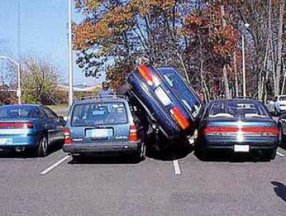
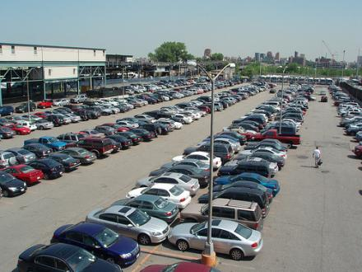
You know – how difficult it is to find an empty parking place
Christmas, Black Friday, Valentines day

Slide 3
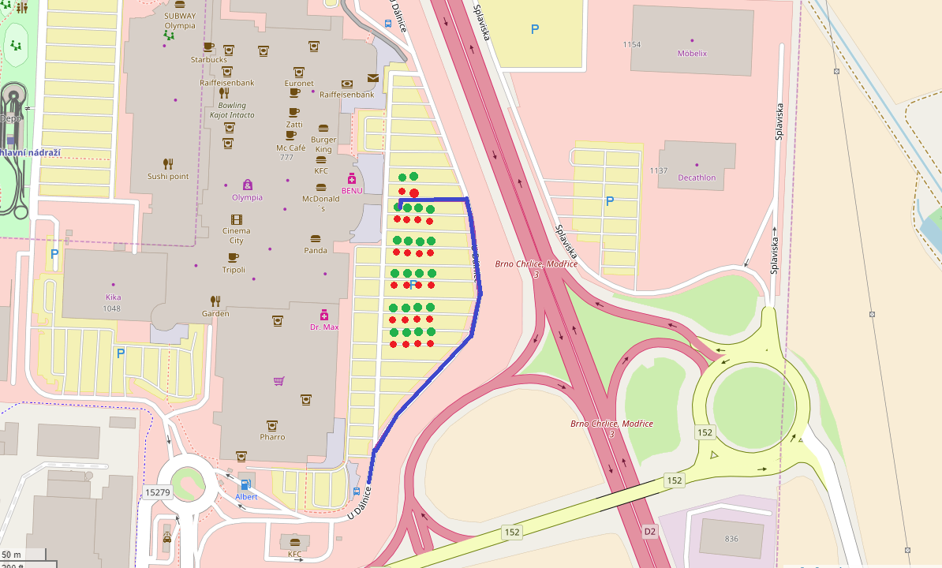
Quick find empty parking place

Slide 4
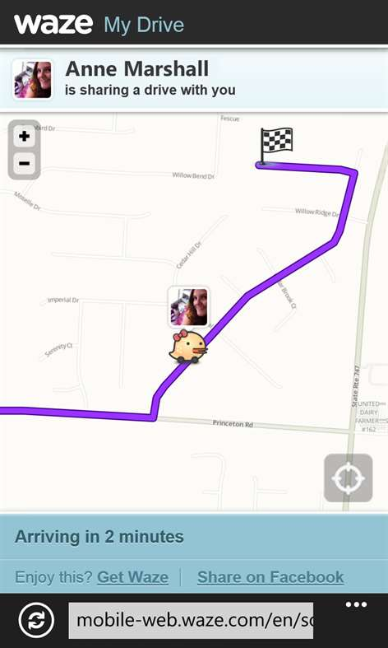
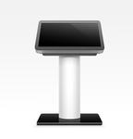
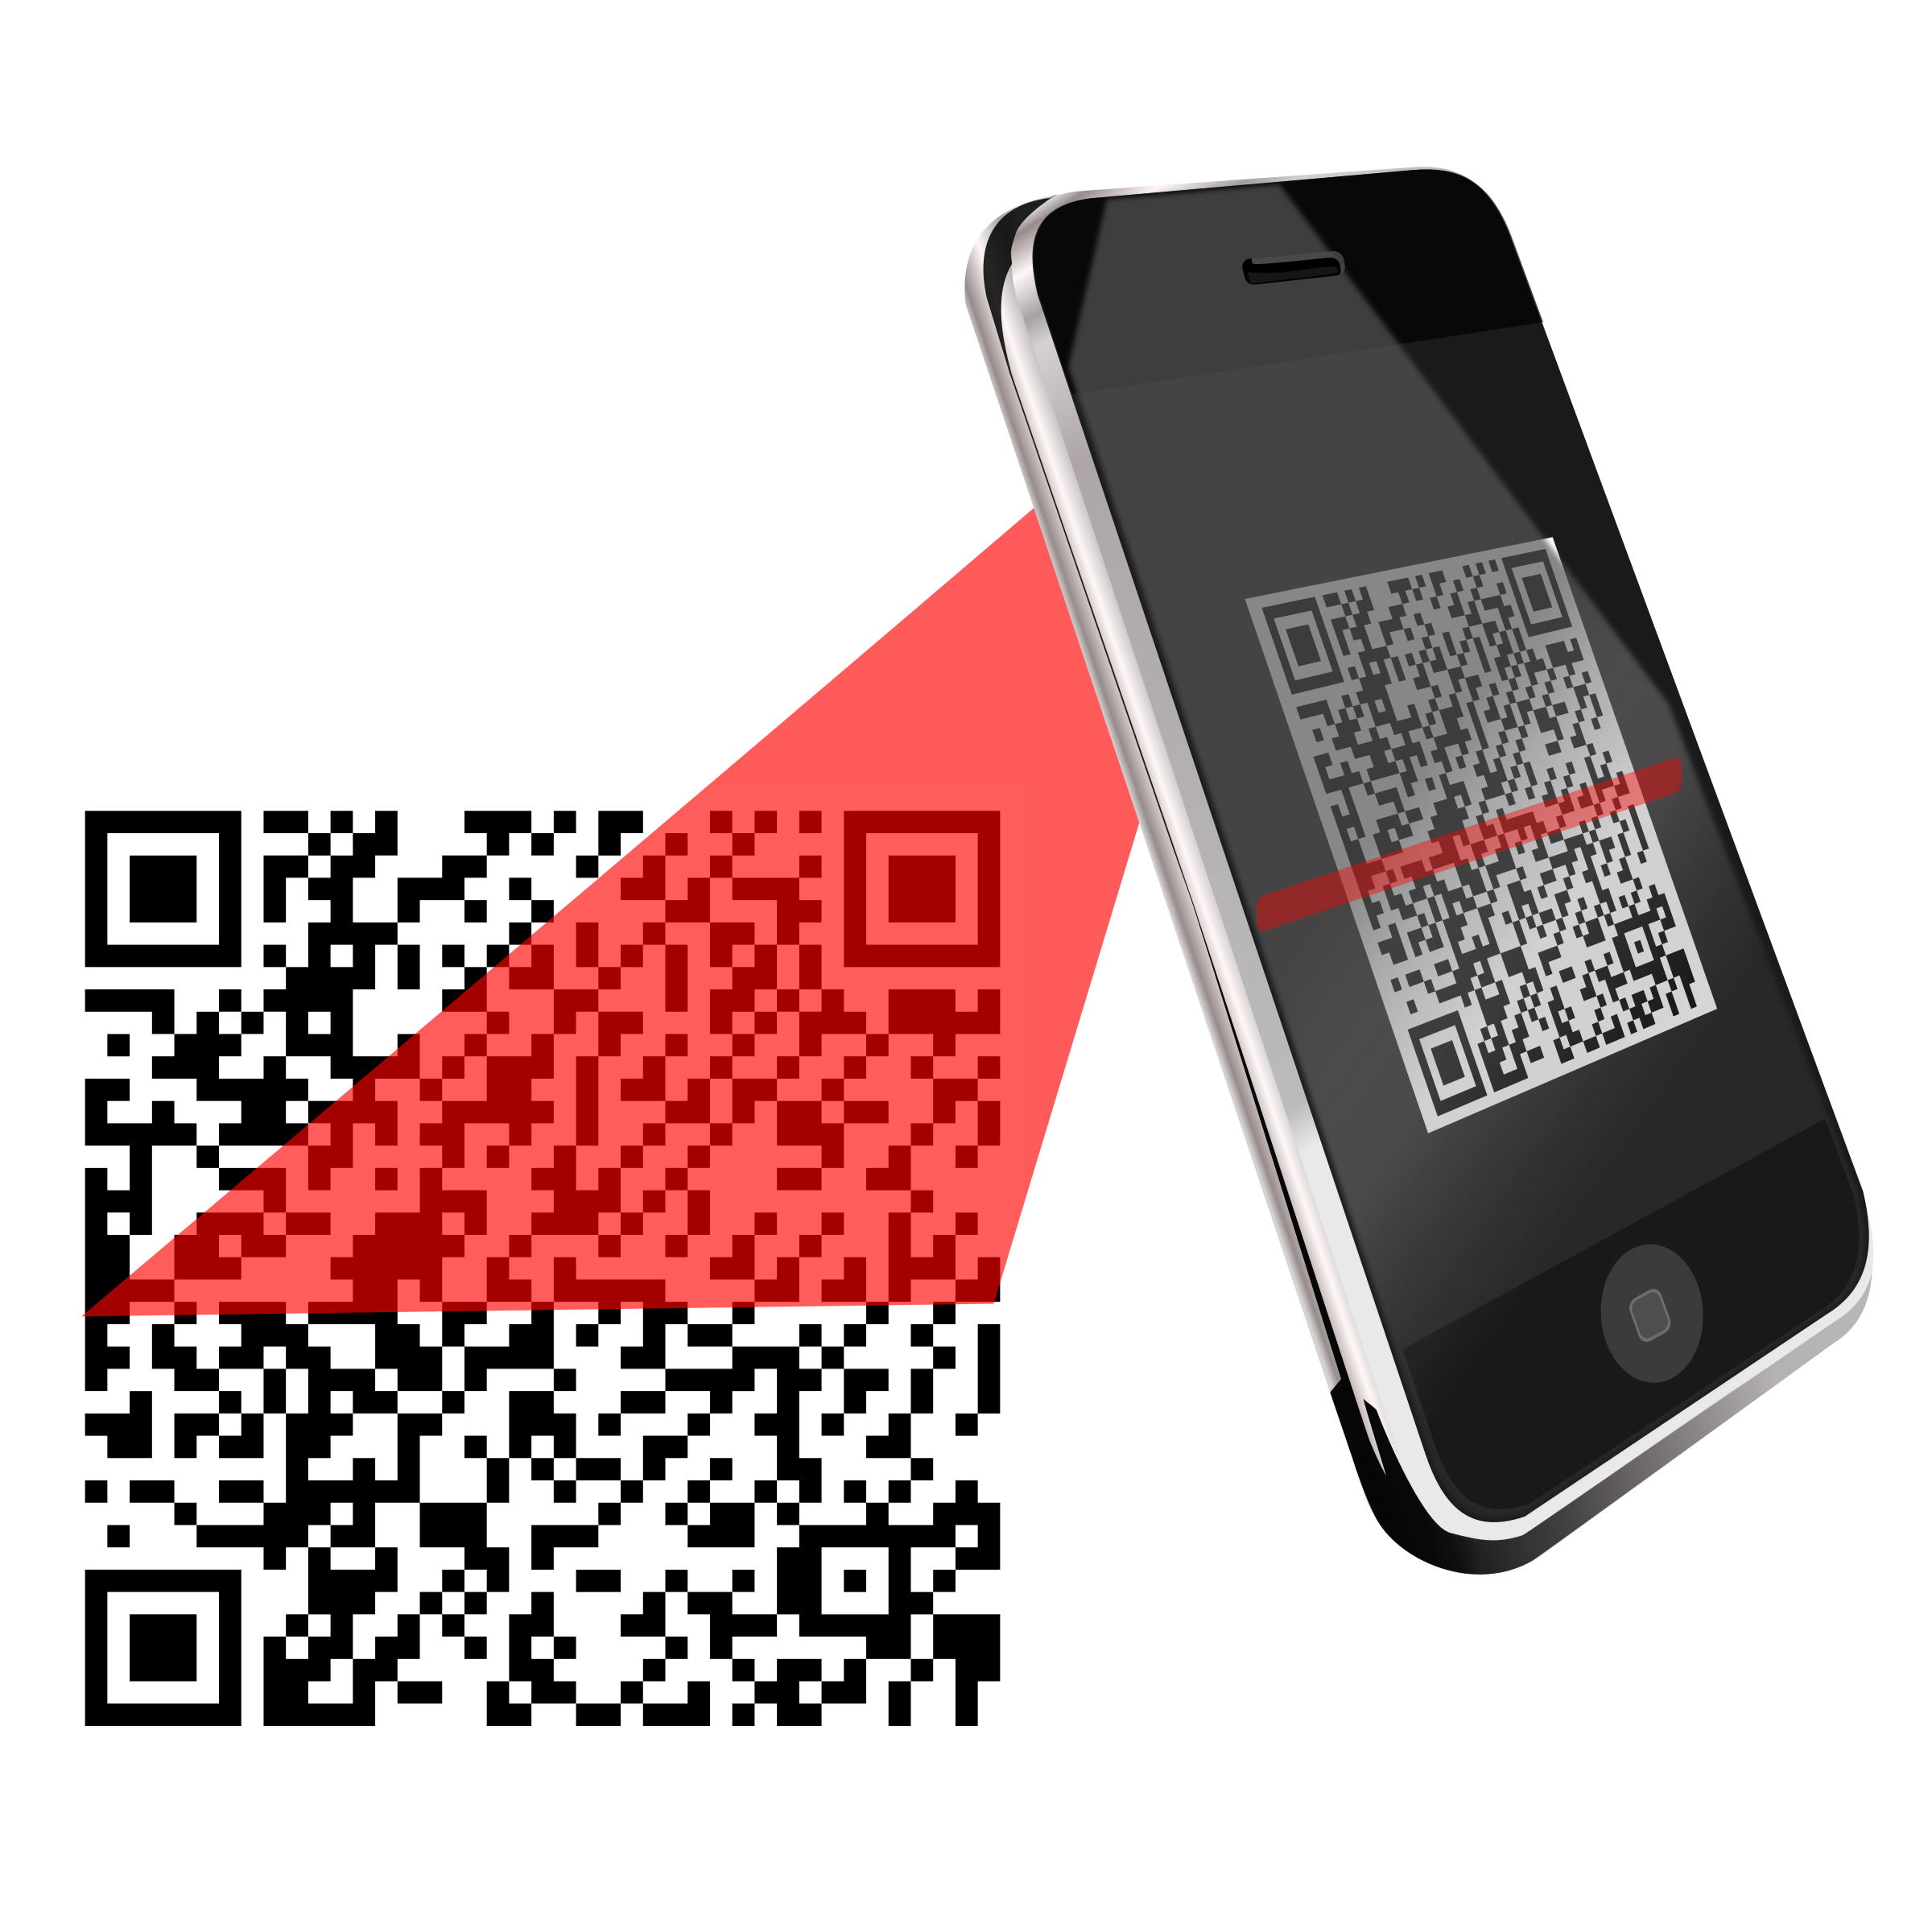
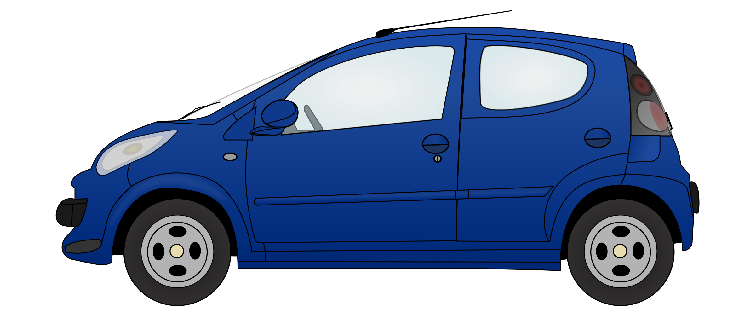

Navigation by QR - code

Slide 5
Statistics
Duration (how long time spend customer in shops) / amount of spend money

Slide 6
Node MCU I.
Node MCU II.
Node MCU n
IoT HUB
Function App
Https
SQL DB
Raspberry Pi
Chrome
Python
http
QR code
Function App
Ajax

Slide 7
Benefits
UX – quick and easy path to the empty parking place for custommer of shop center
Pro developera – spokojený zákazník, přidaná hodnota pro nákupní středisko
Pro nákupní středisko – spokojený zákazník a data o zákaznících
Pro zákazníka – rychle zaparkuje, bonus program od nákupního střediska
Ekologie – snížení emisí v parkovacích domech

Slide 8
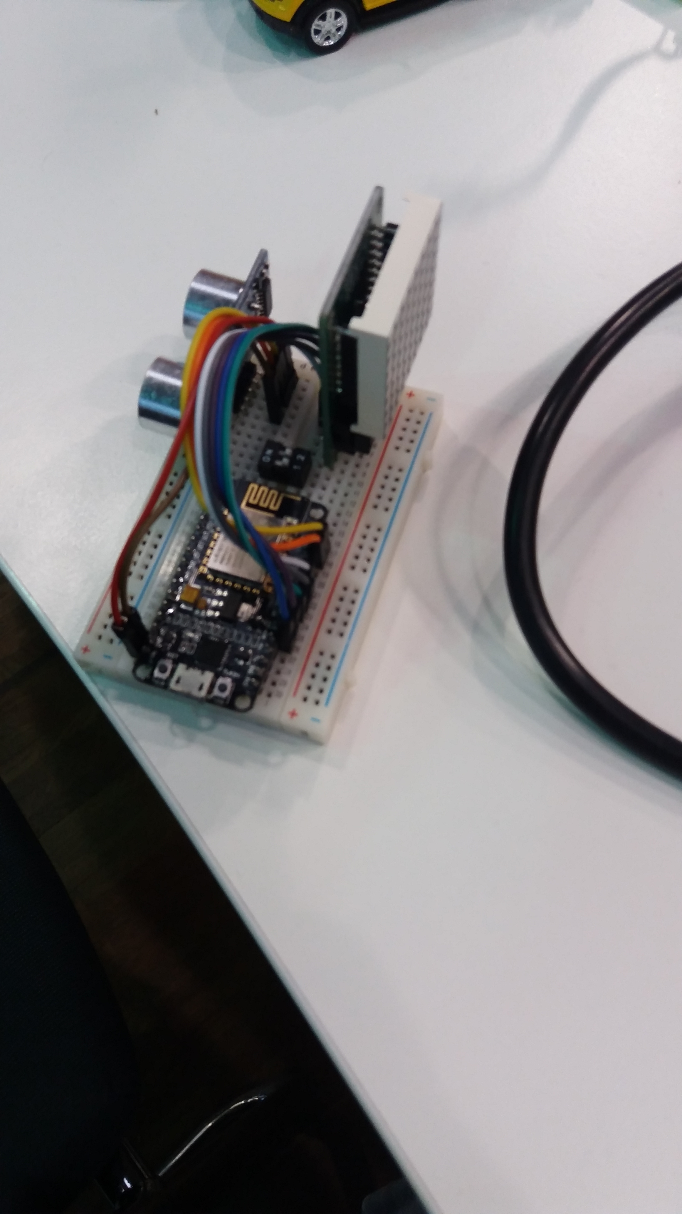
Used technologies
Node MCU
Ultrasonic Sensor
(Matrix LED Display)
WiFi
GPS
QR – code
Cell phone

Slide 9
Scenario
Visitor comes by car infront the gate to parking place with barier
Press button for porking ticket
QR-code is shows on display. Code contains GPS coordinates to empty parking place
Visitor scanes the QR-code by smart phone, then a ten spustí navigaci na volné parkovací místo

Slide 10

Future features
Wireless communication through IQRF
Communication with cell prone through NFC
Pay for parking by cell phone

